Slide 1
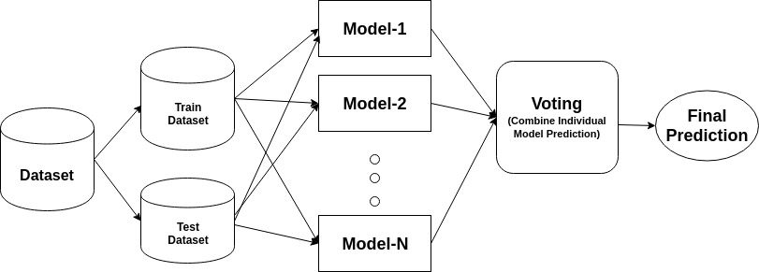
ADA BOOST ALGORITHM
NOTES TO UNDERSTSND:
1)Start with a Basic Model:
2)Focus on Mistakes:
3)Give More Weight to Mistakes:
4)Train a New Model:
5)Combine Models:

Slide 2
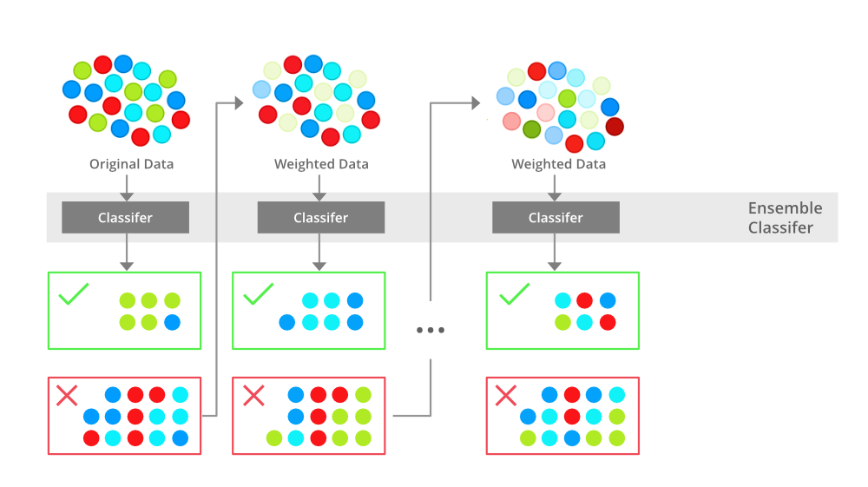
XG OR Gradient boost algorithm
To understand:
1)Build Gradually:
2)Focus on Errors:
3)Optimize Custom Loss Functions:
4)Combine Models:

Slide 3
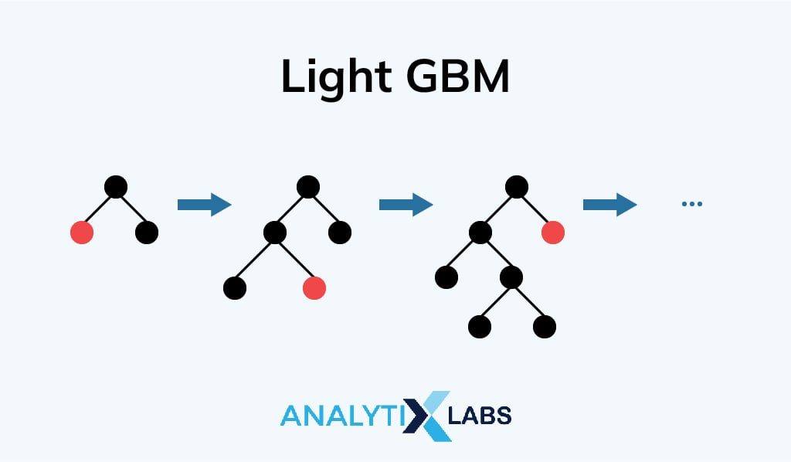
LIGHT GRADIENT BOOST ALGORITHM
TO UNDERSTAND:
1)Start with a Basic Model:
2)Focus on Errors:
3)Build New Trees:
4)Combine Models:
5)Use Efficient Techniques:
*Histogram-Based Splitting:
*Gradient-Based Sampling:
*Feature Bundling:

